Slide 1

Catheter-associated Urinary Tract Infection (CAUTI) Toolkit
Activity C: ELC Prevention Collaboratives
Carolyn Gould, MD MSCR
Division of Healthcare Quality Promotion
Centers for Disease Control and Prevention
Disclaimer: The findings and conclusions in this presentation are those of the authors and do not necessarily represent the views of the Centers for Disease Control and Prevention.

Slide 2
Outline
Background
  Impact
  HHS Prevention Targets
  Pathogenesis
  Epidemiology
Prevention Strategies
  Core
  Supplemental
Measurement
  Process
  Outcome
Tools for Implementation/Resources/References

Slide 3
Background: Impact of CAUTI
Most common type of healthcare-associated infection
  > 30% of HAIs reported to NHSN
  Estimated > 560,000 nosocomial UTIs annually
Increased morbidity & mortality
  Estimated 13,000 attributable deaths annually
  Leading cause of secondary BSI with ~10% mortality
Excess length of stay –2-4 days
Increased cost – $0.4-0.5 billion per year nationally
Unnecessary antimicrobial use
Hidron AI et al. ICHE 2008;29:996-1011 Givens CD, Wenzel RP. J Urol 1980;124:646-8
Klevens RM et al. Pub Health Rep 2007;122:160-6 Green MS et al. J Infect Dis 1982;145:667-72
Weinstein MP et al. Clin Infect Dis 1997;24:584-602 Foxman B. Am J Med 2002;113:5S-13S
Cope M et al. Clin Infect Dis 2009;48:1182-8 Saint S. Am J Infect Control 2000;28:68-75
Notes:
Each episode of SUTI costs additional $676; bacteremia: $2836

Slide 4
Background: Urinary Catheter Use
15-25% of hospitalized patients
5-10% (75,000-150,000) NH residents
Often placed for inappropriate indications
Physicians frequently unaware
In a recent survey of U.S. hospitals:
  > 50% did not monitor which patients catheterized
  75% did not monitor duration and/or discontinuation
Weinstein JW et al. ICHE 1999;20:543-8 Munasinghe RL et al. ICHE 2001;22:647-9
Warren JW et al. Arch Intern Med 1989;149:1535-7 Saint S et al. Am J Med 2000;109:476-80
Benoit SR et al. J Am Geriatr Soc 2008;56:2039-44 Jain P et al. Arch Intern Med 1995;155:1425-9
Rogers MA et al J Am Geriatr Soc 2008;56:854-61 Saint S. et al. Clin Infect Dis 2008;46:243-50

Slide 5
Background:
HHS Metrics and Prevention Targets
# of symptomatic UTI / 1,000 urinary catheter days as measured in NHSN
  National 5-Year Prevention Target: 25% decrease from baseline
Appendix G in HHS plan discusses a new type of metric, the standardized infection ratio (SIR)
http://www.hhs.gov/ophs/initiatives/hai/prevtargets.html
http://www.hhs.gov/ophs/initiatives/hai/appendices.html
Notes:
Several challenges and needs related to the measurement of CAUTIs were identified.
Participants suggested a comparison of NHSN symptomatic UTI (or available state data collecting similar variables) to administrative discharge data and a review of the UTI definition in non-acute care settings to validate data quality and ensure monitoring of the full burden of CAUTIs. Many experts pointed out current limitations of the UTI definition and proposed that the metric should focus only on bloodstream infections secondary to UTIs.
In addition, participants suggested that strategies to widely implement “best practices” in the prevention of CAUTIs in a range of settings be developed. Participants felt that these actions would help identify targets and play a vital role in the selection of future metrics.

Slide 6
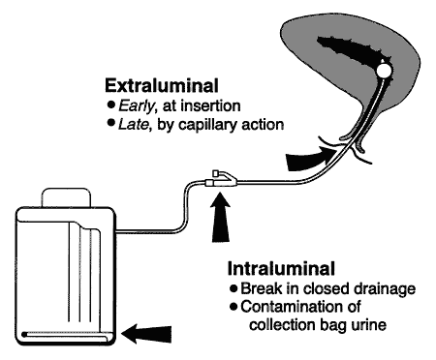
Background: Pathogenesis of CAUTI
* Source of microorganisms may be endogenous (meatal, rectal, or vaginal colonization) or exogenous, usually via contaminated hands of healthcare personnel during catheter insertion or manipulation of the collecting system
Figure from: Maki DG, Tambyah PA. Emerg Infect Dis 2001;7:1-6
Notes:
Most microorganisms causing endemic CAUTI derive from the patient's own colonic and perineal flora or from the hands of health-care personnel during catheter insertion or manipulation of the collection system. Organisms gain access in one of two ways (Figure 1). Extraluminal contamination may occur early, by direct inoculation when the catheter is inserted, or later, by organisms ascending from the perineum by capillary action in the thin mucous film contiguous to the external catheter surface. Intraluminal contamination occurs by reflux of microorganisms gaining access to the catheter lumen from failure of closed drainage or contamination of urine in the collection bag.
Recent studies suggest that CAUTIs most frequently stem from microorganisms gaining access to the bladder extraluminally, but both routes are important (Table 2) (16). Some studies suggest that the extraluminal route may be of greater relative importance in women because of the short urethra and its close proximity to the anus (17). Investigators have found that antecedent heavy periurethral cutaneous colonization is an important risk factor for CAUTI in both men and women (17,18).

Slide 7
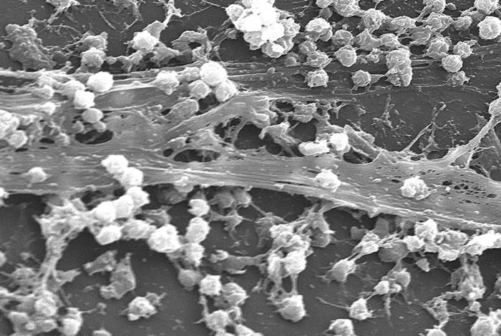
Background: Pathogenesis of CAUTI
Formation of biofilms by urinary pathogens common on the surfaces of catheters and collecting systems
Bacteria within biofilms resistant to antimicrobials and host defenses
Some novel strategies in CAUTI prevention have targeted biofilms
Scanning electron micrograph of S. aureus bacteria on the luminal surface of an indwelling catheter with interwoven complex matrix of extracellular polymeric substances known as a biofilm
Photograph from CDC Public Health Image Library: http://phil.cdc.gov/phil/details.asp

Slide 8
CAUTI Definitions
Surveillance definitions for UTI recently modified in NHSN (as of Jan 2009)
  Please refer to NHSN Patient Safety Manual http://www.cdc.gov/nhsn/library.html
Count symptomatic UTI (SUTI) only, not asymptomatic bacteriuria (ASB)
  Exception is “ABUTI” (asymptomatic bacteremic UTI) – see NHSN manual above
Clinical significance of ASB unclear
  Should not screen for or treat ASB routinely, except in certain clinical situations
  Most literature to date includes ASB in outcomes, making interpretation of data difficult

Slide 9
Evidence-based Risk Factors for CAUTI
Symptomatic UTI | Bacteriuria
Prolonged catheterization* | Disconnection of drainage system*
Female sex† | Lower professional training of inserter*
Older age† | Placement of catheter outside of OR†
Impaired immunity† | Incontinence†
 | Diabetes
 | Meatal colonization
 | Renal dysfunction
 | Orthopaedic/neurology services
* Main modifiable risk factors † Also inform recommendations

Slide 10
Prevention Strategies
Core Strategies
  High levels of scientific evidence
  Demonstrated feasibility
Supplemental Strategies
  Some scientific evidence
  Variable levels of feasibility
*The Collaborative should at a minimum include core prevention strategies. Supplemental prevention strategies also may be used. Most core and supplemental strategies are based on HICPAC guidelines. Strategies that are not included in HICPAC guidelines will be noted by an asterisk (*) after the strategy. HICPAC guidelines may be found at www.cdc.gov/hicpac

Slide 11
Core Prevention Strategies
(all Category IB)
Insert catheters only for appropriate indications
Leave catheters in place only as long as needed
Ensure that only properly trained persons insert and maintain catheters
Insert catheters using aseptic technique and sterile equipment (acute care setting)
Following aseptic insertion, maintain a closed drainage system
Maintain unobstructed urine flow
Hand hygiene and Standard (or appropriate isolation) Precautions
http://www.cdc.gov/hicpac/cauti/001_cauti.html

Slide 12
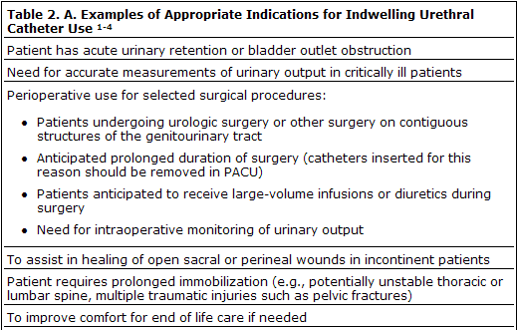
Core Prevention Strategies
Specific recommendations (IB)
Insert catheters only for appropriate indications
http://www.cdc.gov/hicpac/cauti/001_cauti.html

Slide 13
Core Prevention Strategies
Specific recommendations (IB)
Insert catheters only for appropriate indications
  Minimize use in all patients, particularly those at higher risk of CAUTI and mortality (women, elderly, impaired immunity)
  Avoid use for management of incontinence
  Use catheters in operative patients only as necessary
http://www.cdc.gov/hicpac/cauti/001_cauti.html

Slide 14
Core Prevention Strategies
Specific recommendations (IB)
Leave catheters in place only as long as needed
  Remove catheters ASAP postoperatively, preferably within 24 hours, unless there are appropriate indications for continued use
http://www.cdc.gov/hicpac/cauti/001_cauti.html

Slide 15
Core Prevention Strategies
Specific recommendations (IB)
Insert catheters using aseptic technique and sterile equipment (acute care setting)
  Perform hand hygiene before and after insertion
  Use sterile gloves, drape, sponges, antiseptic or sterile solution for periurethral cleaning, single-use packet of lubricant jelly
  Properly secure catheters
http://www.cdc.gov/hicpac/cauti/001_cauti.html

Slide 16
Core Prevention Strategies
Specific recommendations (IB)
Following aseptic insertion, maintain a closed drainage system
  If breaks in aseptic technique, disconnection, or leakage occur, replace catheter and collecting system using aseptic technique and sterile equipment
  Consider systems with preconnected, sealed catheter-tubing junctions (II)
  Obtain urine samples aseptically
http://www.cdc.gov/hicpac/cauti/001_cauti.html

Slide 17
Core Prevention Strategies
Specific recommendations (IB)
Maintain unobstructed urine flow
  Keep catheter and collecting tube free from kinking
  Keep collecting bag below level of bladder at all times (do not rest bag on floor)
  Empty collecting bag regularly using a separate, clean container for each patient. Ensure drainage spigot does not contact nonsterile container.
http://www.cdc.gov/hicpac/cauti/001_cauti.html

Slide 18
Core Prevention Strategies:
Specific recommendations (IB)
Implement quality improvement programs to enhance appropriate use of indwelling catheters and reduce risk of CAUTI
Examples:
  Alerts or reminders
  Stop orders
  Protocols for nurse-directed removal of unnecessary catheters
  Guidelines/algorithms for appropriate perioperative catheter management
http://www.cdc.gov/hicpac/cauti/001_cauti.html

Slide 19
Supplemental Prevention
Strategies: Examples
Consideration of alternatives to indwelling urinary catheterization (II)
Use of portable ultrasound devices for assessing urine volume to reduce unnecessary catheterizations (II)
Use of antimicrobial/antiseptic-impregnated catheters (IB, after first implementing core recommendations for use, insertion, and maintenance )
The following slides will provide further details on supplemental strategies…
http://www.cdc.gov/hicpac/cauti/001_cauti.html

Slide 20
Supplemental Prevention Strategies:
Alternatives to Indwelling Catheterization
http://www.cdc.gov/hicpac/cauti/001_cauti.html
Intermittent catheterization – consider for:
  Patients requiring chronic urinary drainage for neurogenic bladder
    Spinal cord injury
    Children with myelomeningocele
  Postoperative patients with urinary retention
  May be used in combination with bladder ultrasound scanners
External (i.e., condom) catheters – consider for:
  Cooperative male patients without obstruction or urinary retention

Slide 21
Supplemental Prevention Strategies:
Bladder Ultrasound Scanners
Rationale: fewer catheterizations = lower risk of UTI
2 studies of adults with neurogenic bladder undergoing intermittent catheterization
Inpatient rehabilitation centers
Fewer catheterizations per day but no reported differences in UTI
  Significant study limitations: likely underpowered; UTIs undefined
Polliak T et al. Spinal Cord 2005;43:615-19
Anton HA et al. Arch Phys Med Rehab 1998;79:172-5

Slide 22
Supplemental Prevention Strategies:
Antimicrobial/Antiseptic-Impregnated Urinary Catheters
Considered using if CAUTI rates not decreasing after implementing a comprehensive strategy
  First implement core recommendations for use, insertion, and maintenance
  Ensure compliance with core recommendations
http://www.cdc.gov/hicpac/cauti/001_cauti.html

Slide 23
Supplemental Prevention Strategies:
Silver-Coated Catheters
Decreased risk of bacteriuria compared to standard latex catheters in a meta-analysis of RCTs
Significant differences for silver alloy but not silver oxide-coated catheters
Effect greater for patients catheterized < 1 week
Mixed results in observational studies in hospitalized patients
  Most used laboratory-based outcomes (bacteriuria)
  1 positive, 2 negative, 5 inconclusive
http://www.cdc.gov/hicpac/cauti/001_cauti.html

Slide 24
Supplemental Prevention Strategies:
Silver-Coated Catheters
One study in a burn referral center found a decrease in SUTI
Pre-intervention catheters standard latex
Intervention group had silver-impregnated catheters and had new catheters inserted on admission under nonemergent sterile conditions
  “The improved results in time period 2 are probably due to the combination of these two changes in therapy.”
Newton et al. Infect Control Hosp Epidemiol 2002;23:217-8

Slide 25
Summary of Prevention Measures*
Core Measures
Supplemental Measures
Insert catheters only for appropriate indications
Leave catheters in place only as long as needed
Only properly trained persons insert and maintain catheters
Insert catheters using aseptic technique and sterile equipment
Maintain a closed drainage system
Maintain unobstructed urine flow
Hand hygiene and standard (or appropriate isolation) precautions
Alternatives to indwelling urinary catheterization
Portable ultrasound devices to reduce unnecessary catheterizations
Antimicrobial/antiseptic-impregnated catheters
*All recommendations in HICPAC guidelines at:
http://www.cdc.gov/hicpac/cauti/001_cauti.html

Slide 26
Strategies NOT recommended for CAUTI prevention
http://www.cdc.gov/hicpac/cauti/001_cauti.html
Complex urinary drainage systems (e.g., antiseptic-releasing cartridges in drain port)
Changing catheters or drainage bags at routine, fixed intervals (clinical indications include infection, obstruction, or compromise of closed system)
Routine antimicrobial prophylaxis
Cleaning of periurethral area with antiseptics while catheter is in place (use routine hygiene)
Irrigation of bladder with antimicrobials
Instillation of antiseptic or antimicrobial solutions into drainage bags
Routine screening for asymptomatic bacteriuria (ASB)

Slide 27
Measurement: Examples of
Process Measures
Compliance with hand hygiene
Compliance with educational program
Compliance with documentation of catheter insertion and removal
Compliance with documentation of indications for catheter placement
http://www.cdc.gov/hicpac/cauti/001_cauti.html

Slide 28
Measurement: Recommended
Outcome Measures
http://www.cdc.gov/hicpac/cauti/001_cauti.html
Examples of metrics:
  Number of CAUTI per 1000 catheter-days
  Number of BSI secondary to CAUTI per 1000 catheter-days
  Catheter utilization ratio (urinary catheter-days/patient-days) x 100
Use CDC/NHSN definitions for numerator data (SUTI only): http://www.cdc.gov/nhsn/library.html

Slide 29
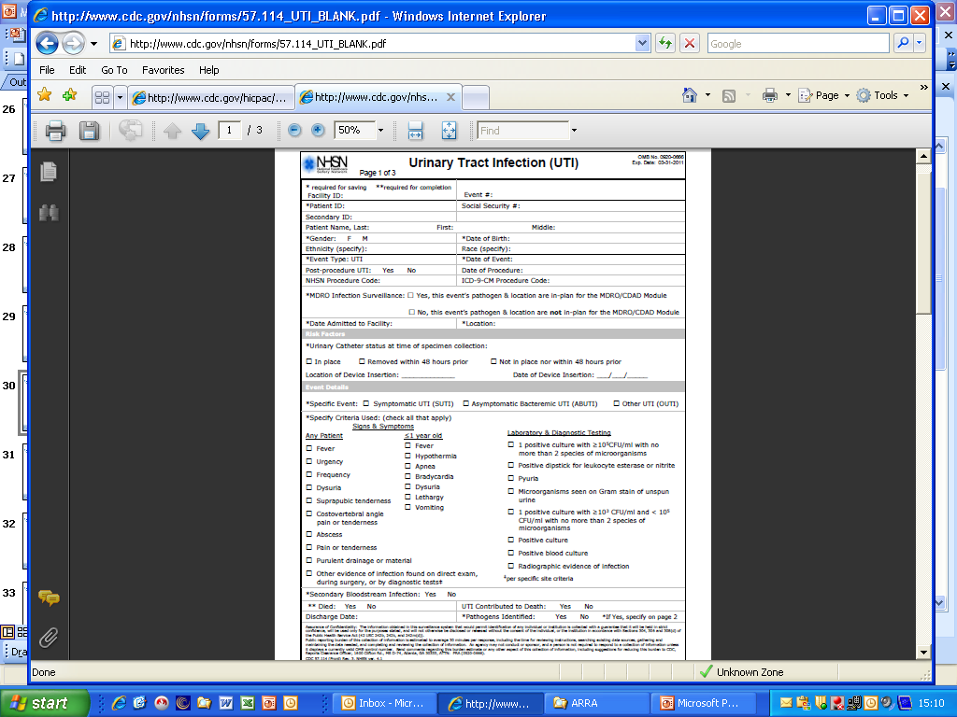
Measurement: Outcome
Use NHSN Device-associated Module
http://www.cdc.gov/nhsn/library.html

Slide 30
Measurement Considerations
May need to consider alternative metrics (in addition to standard rates by device days) to demonstrate a reduction in CAUTIs if catheter days (denominators) greatly reduced with interventions
Alternative denominator examples:
  Patient days on unit
  Numbers of catheters inserted

Slide 31
Evaluation Considerations
Assess baseline policies and procedures
Areas to consider
  Surveillance
  Prevention strategies
  Measurement
Coordinator should track new policies/practices implemented during collaboration

Slide 32
References/resources
Gould CV, Umscheid CA, Agarwal RK, Kuntz G, Pegues DA, and HICPAC. Guideline for Prevention of Catheter-associated Urinary Tract Infections 2009.http://www.cdc.gov/hicpac/cauti/001_cauti.html
  IHI Program to Prevent CAUTI http://www.ihi.org/
  APIC CAUTI Elimination Guide http://www.apic.org/
  IDSA Guidelines (Clin Infect Dis 2010;50:625-63)
  SHEA/IDSA Compendium (ICHE 2008;29:S41-S50)
  National Quality Forum (NQF) Safe Practices for Better Healthcare – Update April 2010
  CDC/Medscape collaboration http://www.cdc.gov/hicpac/

