Slide 1
Addressing Common Barriers to Generating Improvements on ADEs
Partnership for Patients
Pacing Event
Tuesday, July 22, 2014
3:00–4:15 pm (ET)

Slide 2

Welcome
Monica Barrington
Premier HEN and MSAG Co-lead

Slide 3
Partnership for Patients Campaign
140 Days and Counting!
Our Patients are Counting on You!

Slide 4
Intent of the Call
Understand how ADEs are a critical component to the national operating system and to evolving a hospital’s culture of safety.
Share national and HEN ADE performance rates and assess opportunities for improvement.
Discuss strategies to overcome barriers to generate improvement in ADE rates in all three high-risk medication classes.

Slide 5
Questions To Run On
What are strategies my HEN can use with hospitals to improve performance in ADEs?
How quickly can my HEN overcome barriers and challenges to transform hospital medication safety, and as part of their efforts to evolve their hospital culture of safety?

Slide 6
Listen and Be Ready To Respond
What barriers did you find most challenging to overcome with your hospitals?
What strategies have you used to overcome these barriers?
What lessons have you learned while working with your hospitals to address challenges in tracking ADEs?

Slide 7
Guiding Principles
Three Categories
  Hospital Safety Improves
  Leaders Surface At All Levels
  Network Safety Trends Improve

Slide 8
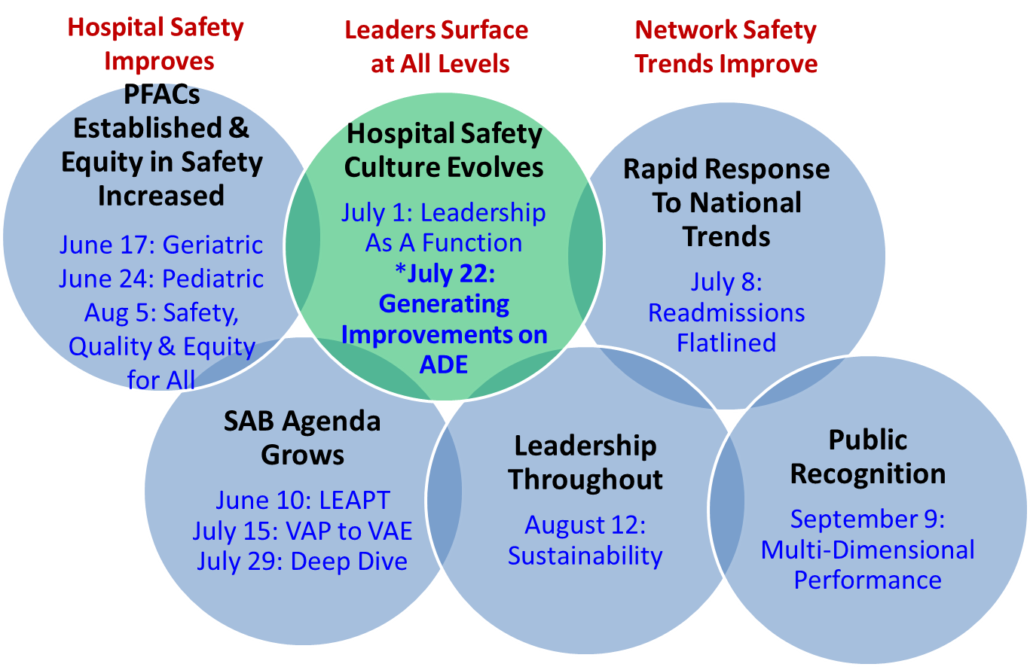
Guiding Principles:
Under Continuous Development and Testing

Slide 9
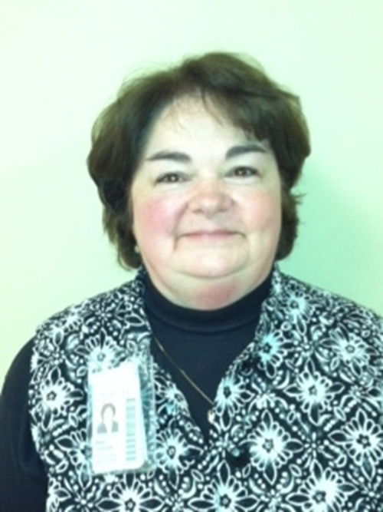
The Patient Voice
Mary Clough, MSN R.N.
Director of Patient Experience
University of Minnesota Health

Slide 10
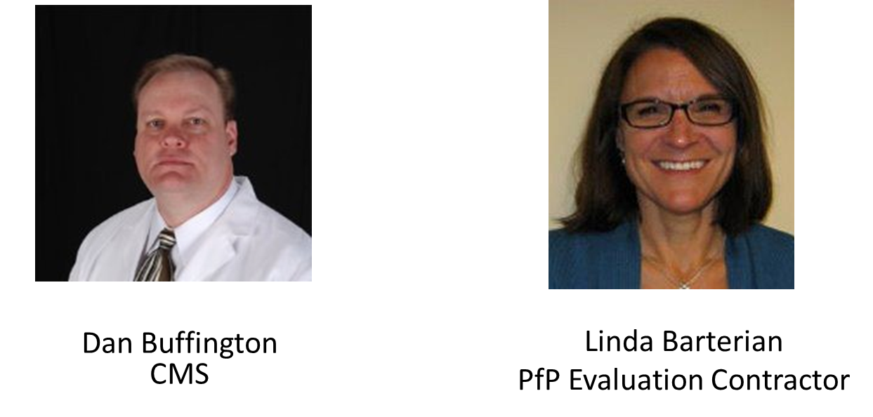
HEN Progress on ADE Reduction

Slide 11
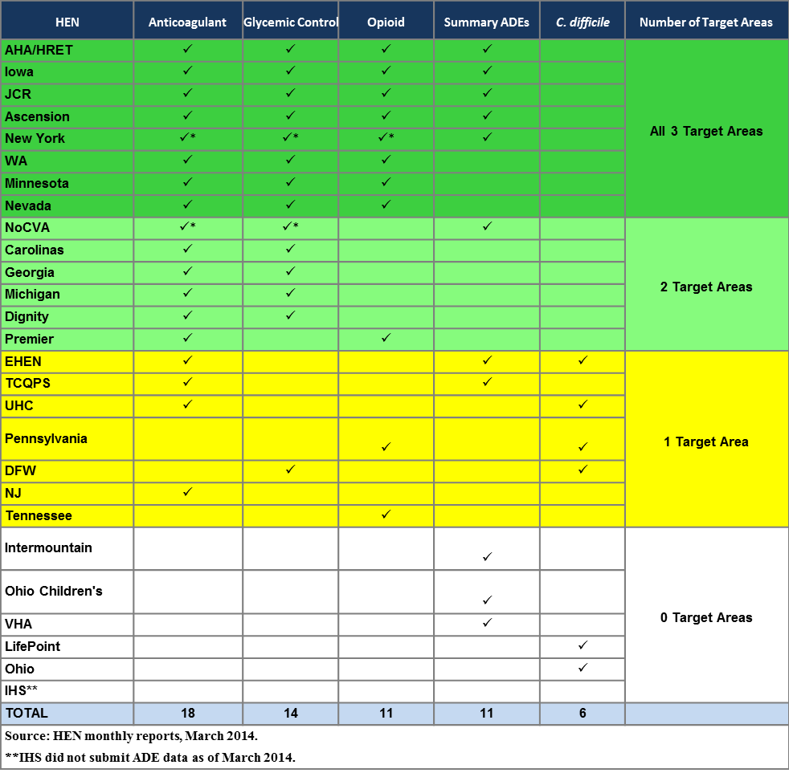
ADE Reporting by HEN: March 2014

Slide 12
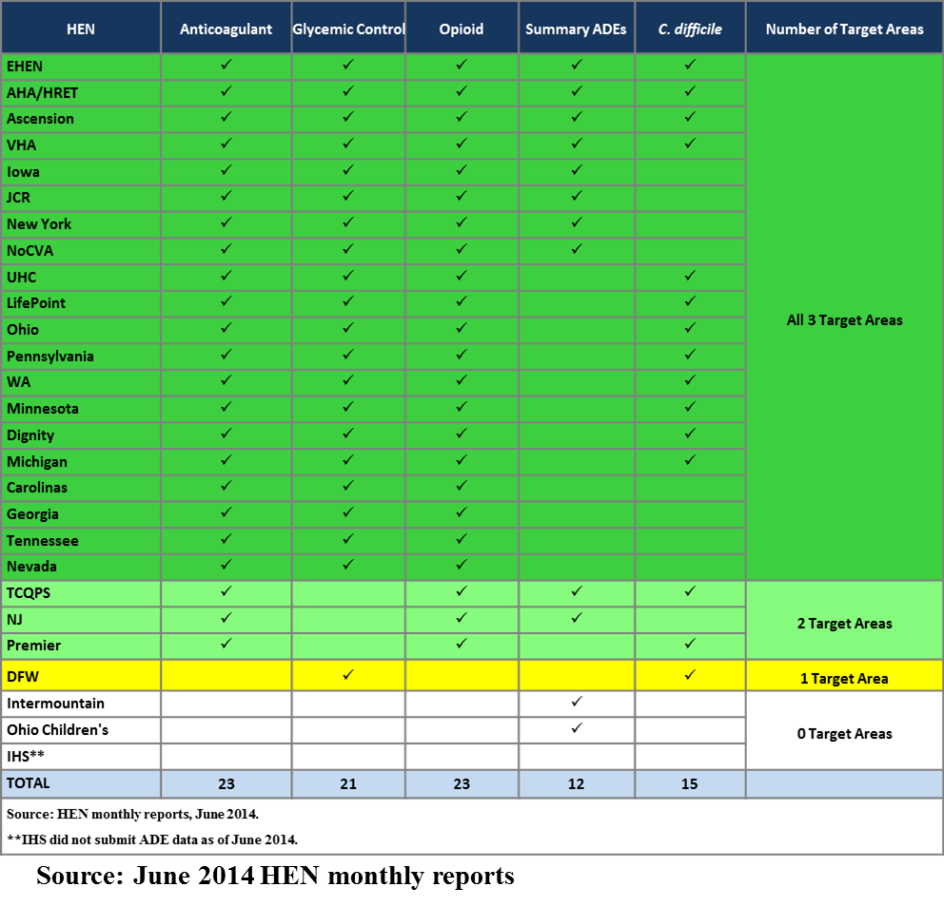
ADE Reporting by HEN: June 2014

Slide 13
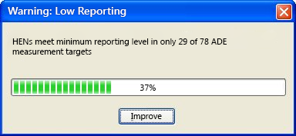
Level of Reporting Remains a Challenge

Slide 14
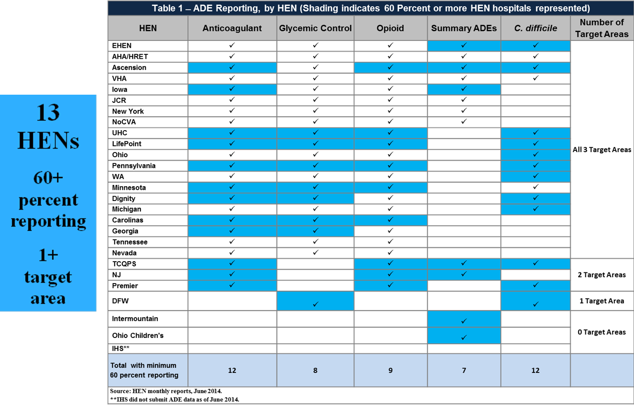
ADE Reporting Level by HEN: June 2014
60+ Percent of Hospitals Represented (shaded)

Slide 15
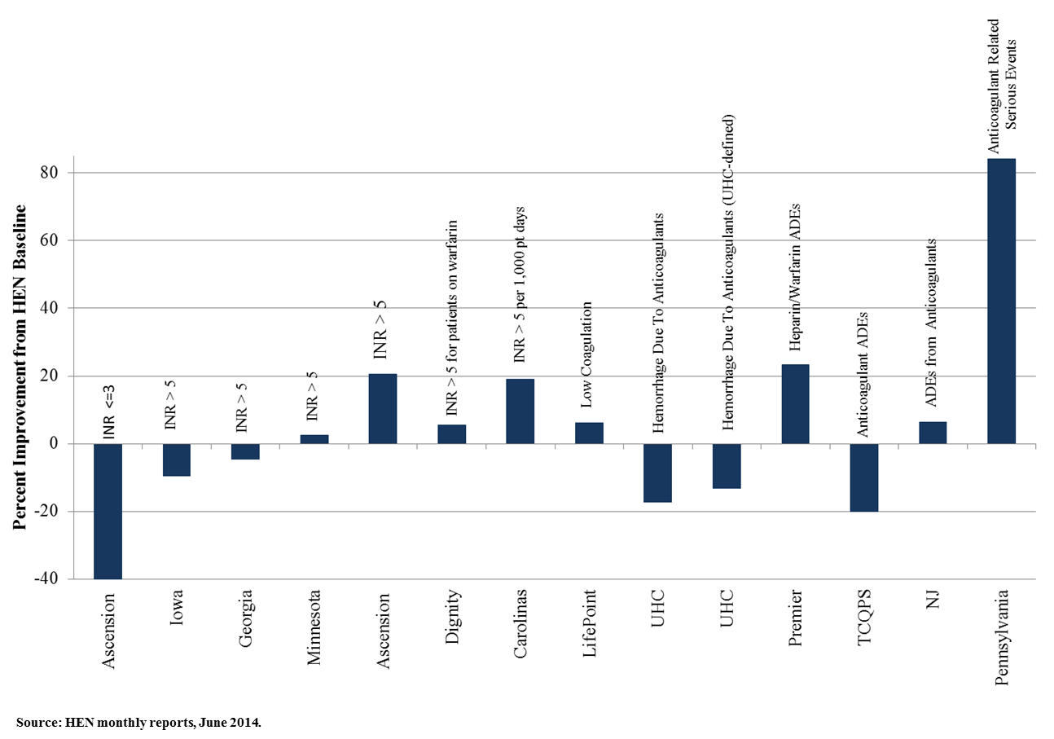
HEN Harm Reduction: ADE - Anticoagulants

Slide 16
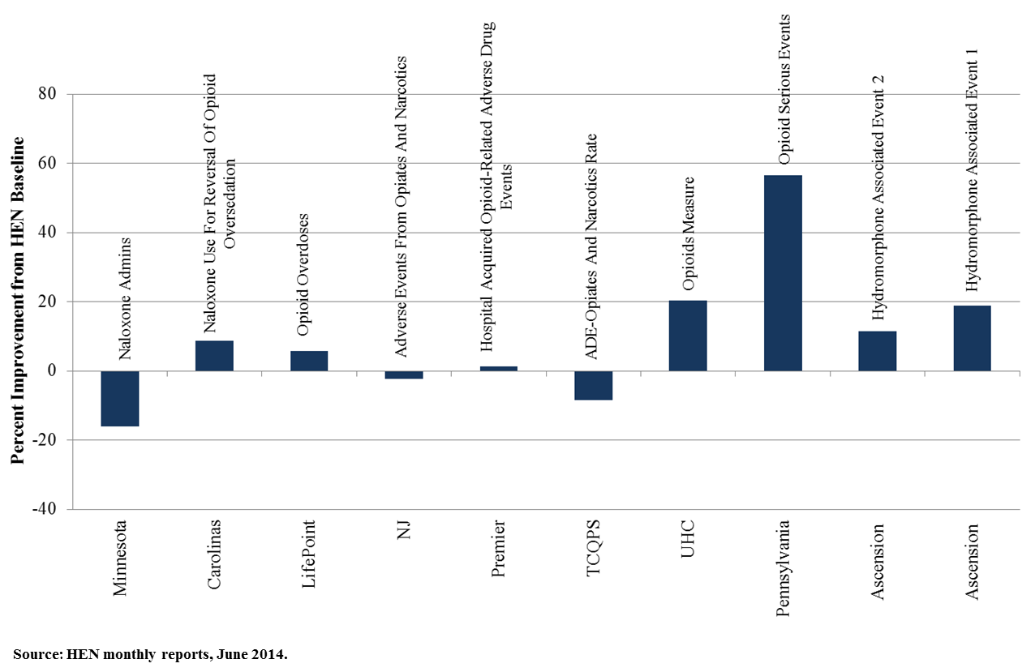
HEN Harm Reduction Progress: ADE - Opioids

Slide 17
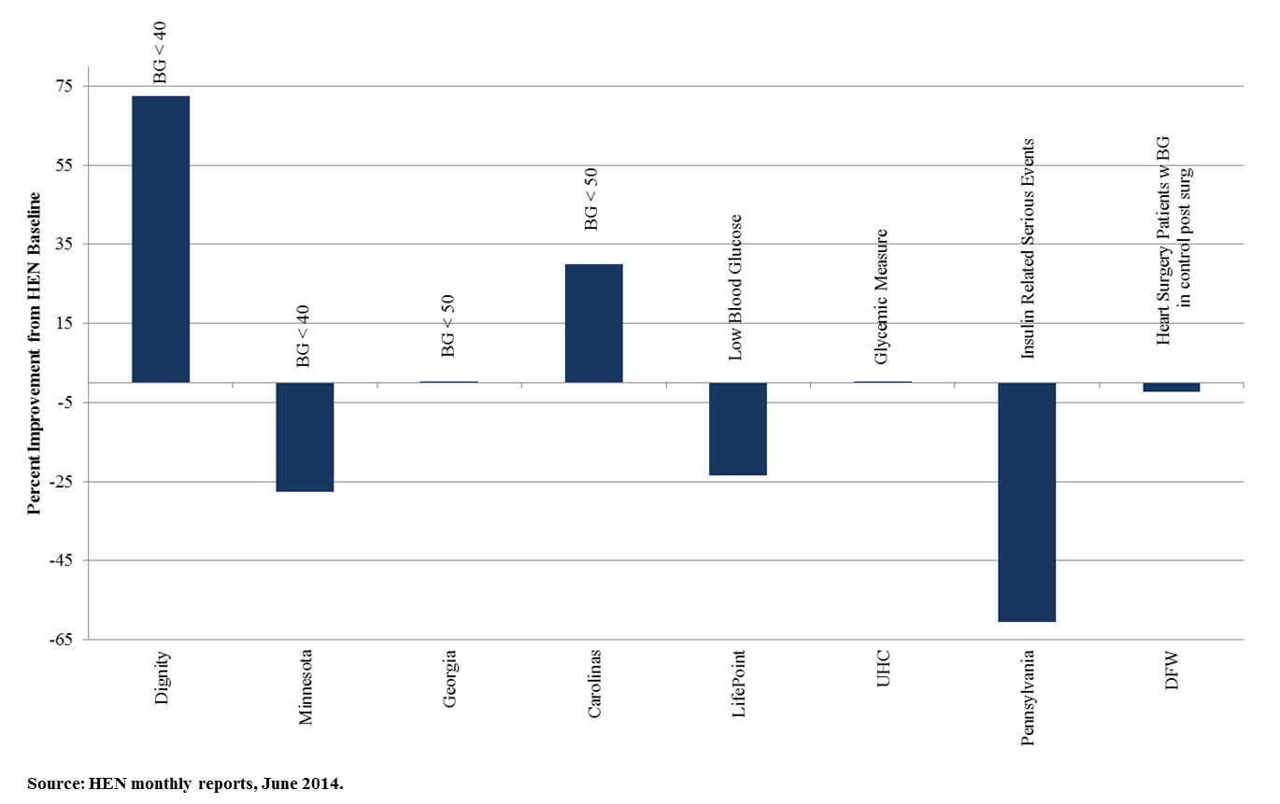
HEN Harm Reduction Progress: ADE – Blood Glucose

Slide 18
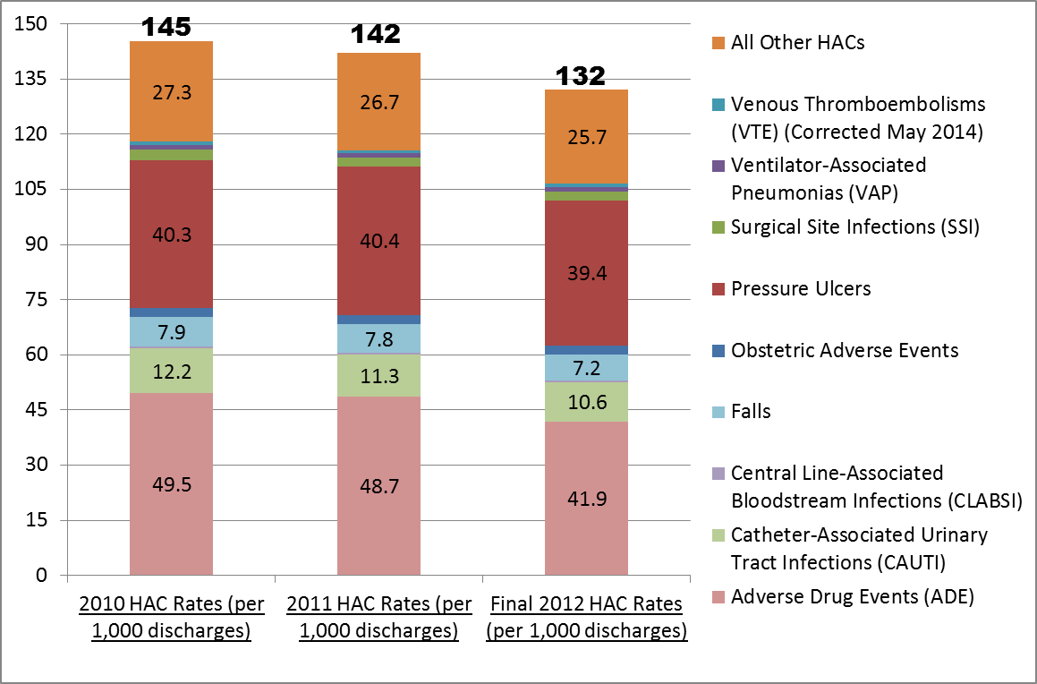
Partnership for Patients AHRQ National Scorecard
Annual HACs Rates for 2010-2012

Slide 19
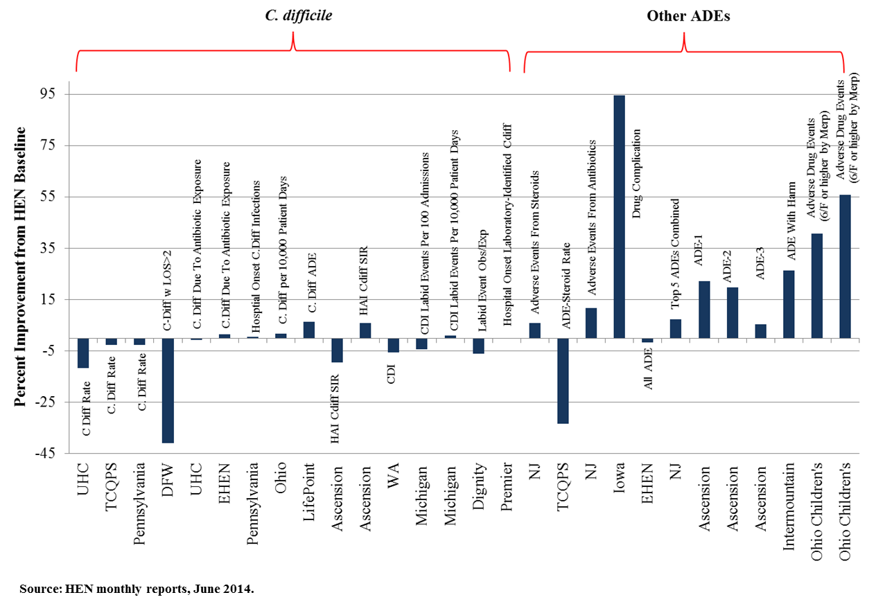
HEN Harm Reduction Progress:
ADE – C. difficile and Other ADE Measures

Slide 20
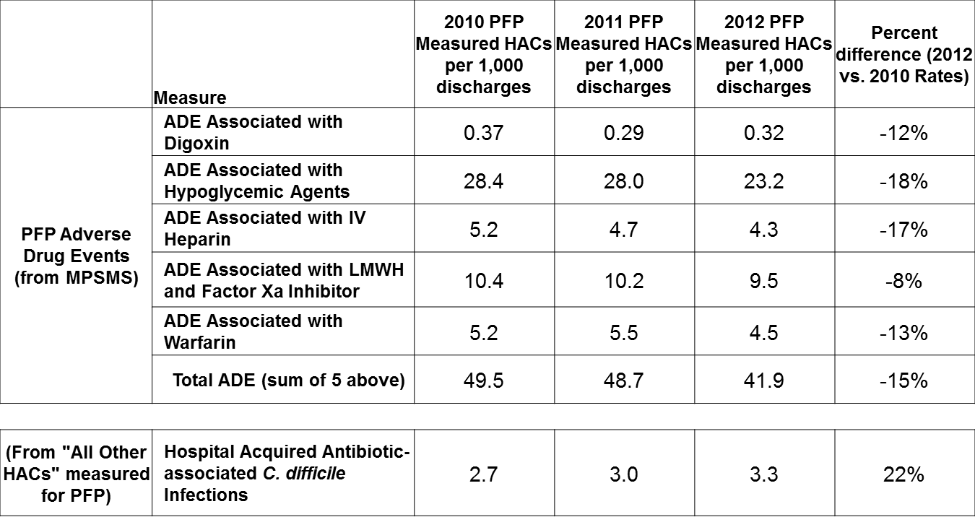
Partnership for Patients AHRQ National Scorecard
Selected Annual HACs Rates for 2010-2012

Slide 21
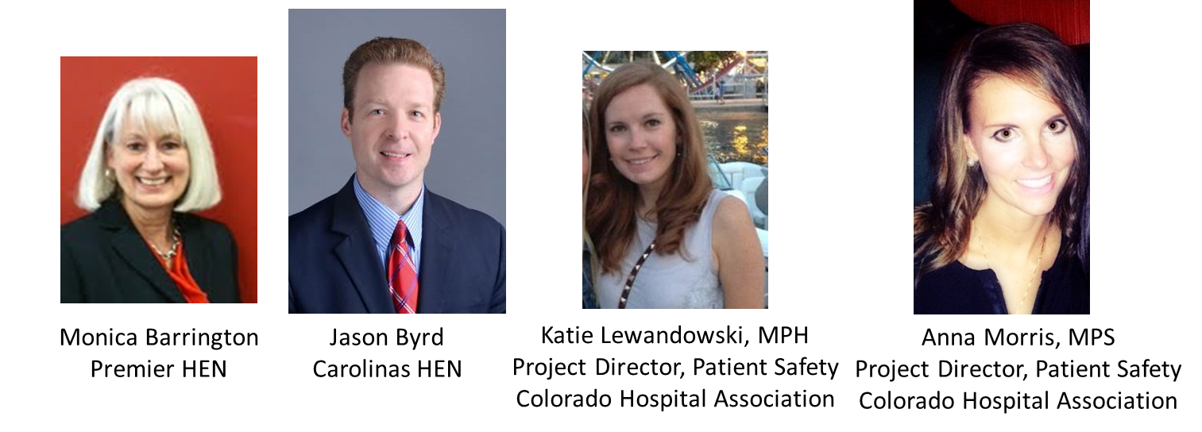
HEN Panel

Slide 22
Principle #5
How a hospital safety culture evolves (to improve ADE)
Monica Barrington, RPH, MPH, FASCP
VP Engagement and Delivery

Slide 23
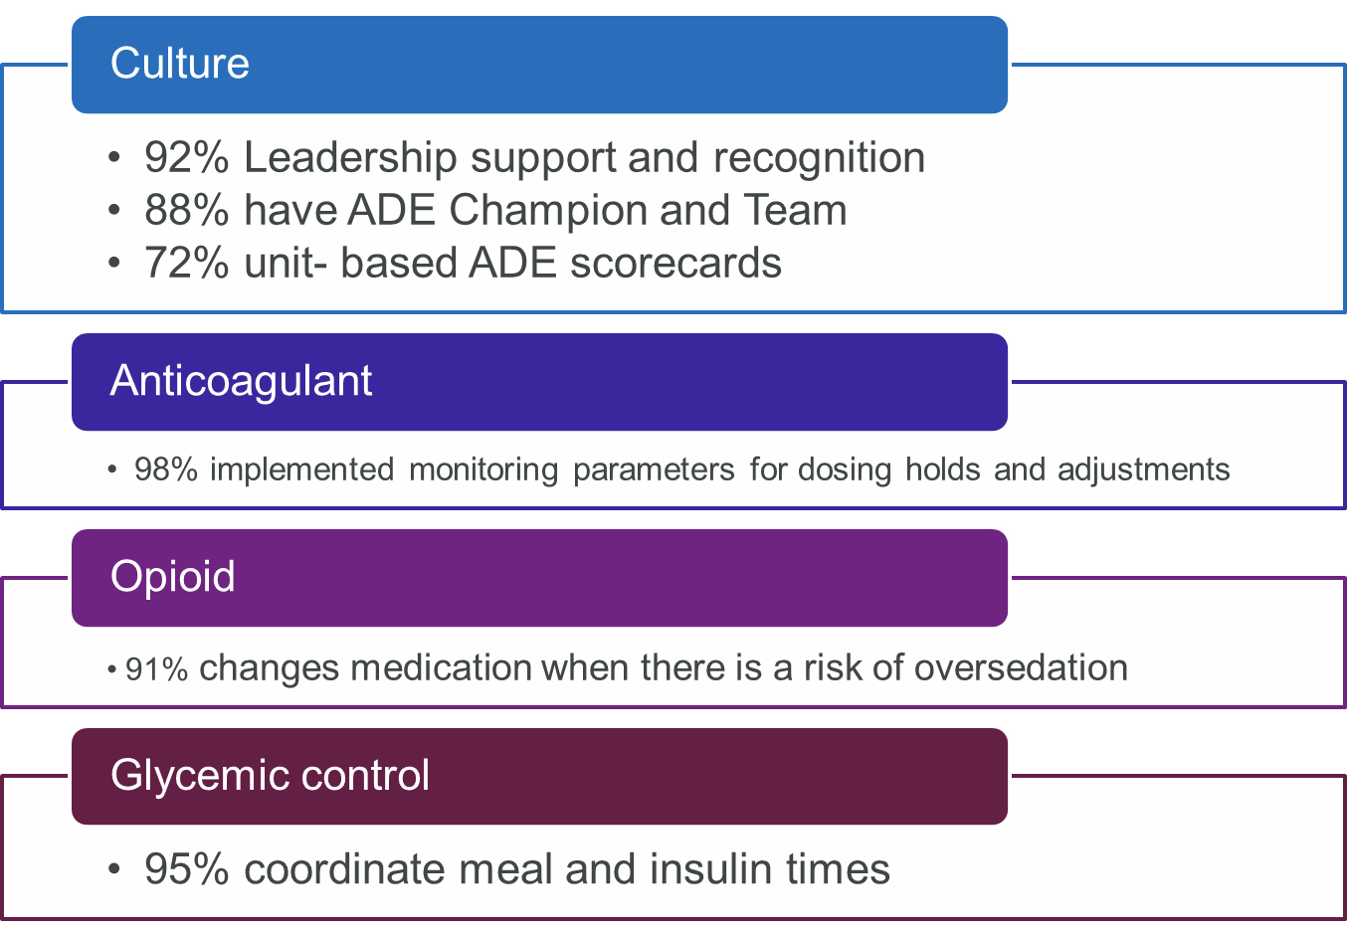
Improvement in ADE Culture and Change Management

Slide 24
Carolinas HealthCare System
Hospital Engagement Network
ADE Update
July 22, 2014

Slide 25
ADE Facts
All facilities participating in all three ADE measures
  INR (INRs > 5), Glucose (glucose <50) since 2012
  Naloxone this year (Naloxone use for reversal of sedation)
Data reporting from all 100% of facilities
  Med Safety QSOC™
    Selected the measure (The How)
    Endorsed the measure (Accountability)
    Working to connect patient experiences to the harm that can result when these conditions occur (The Why)
  The group pushed for measures that were easy to collect and meaningful so the work is where the time is spent

Slide 26
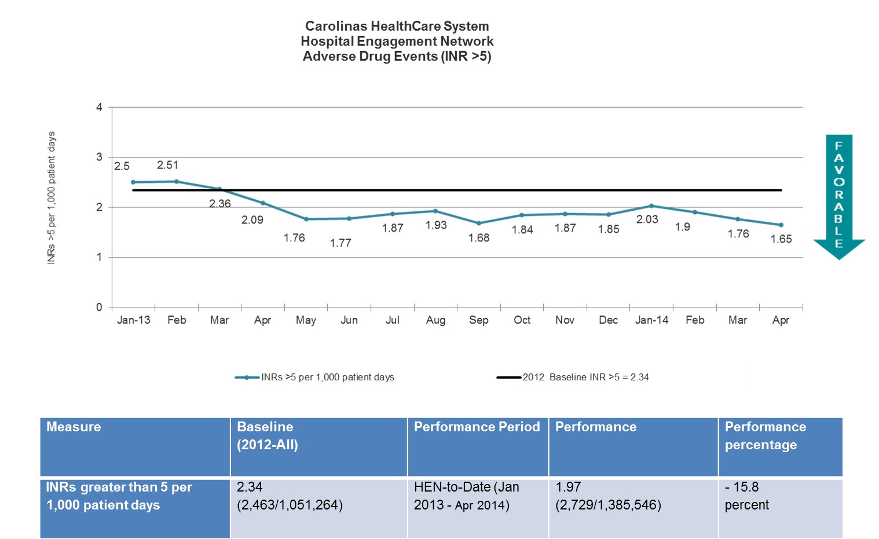
ADE Charts

Slide 27
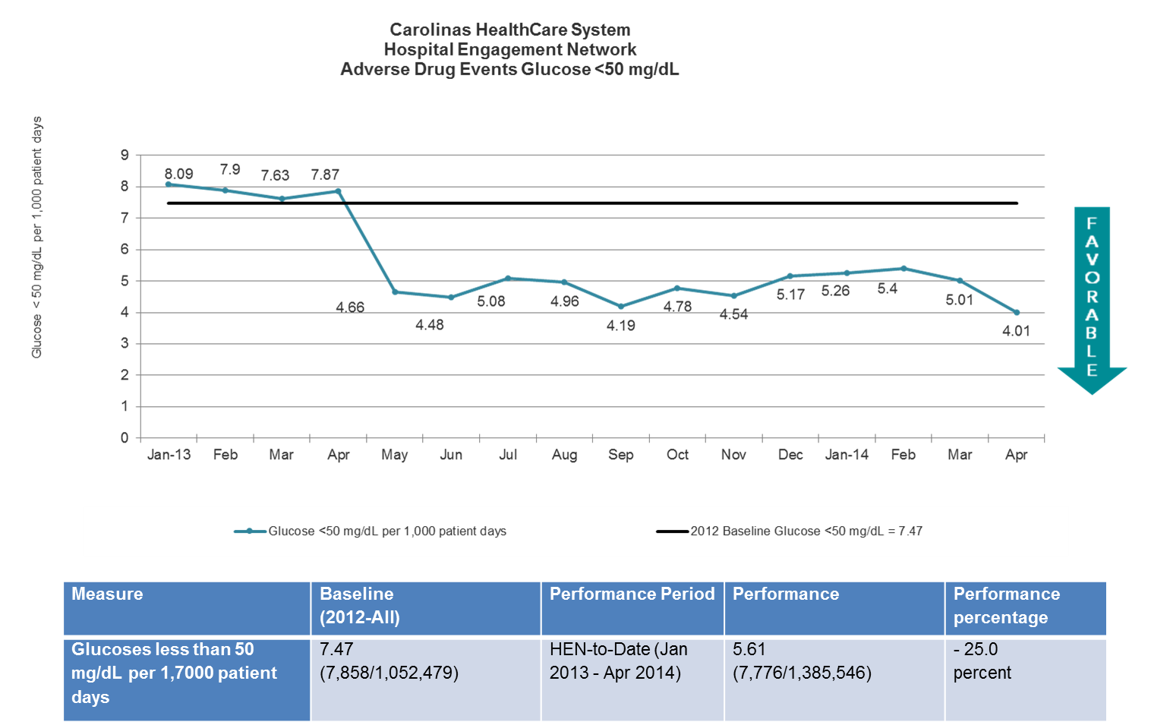
ADE Charts 2

Slide 28
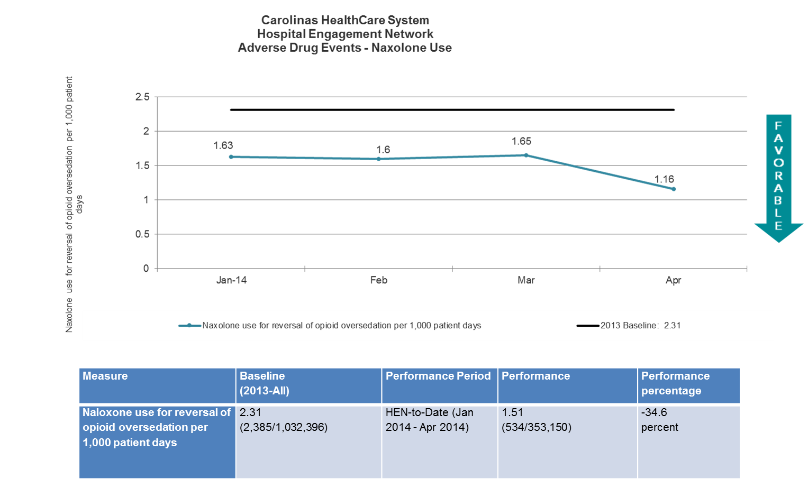
ADE Charts 3

Slide 29


Colorado Hospital Association
Katie Lewandowski, MPH
Project Director, Patient Safety
Colorado Hospital Association
Anna Morris, MPS
Project Director, Patient Safety
Colorado Hospital Association

Slide 30
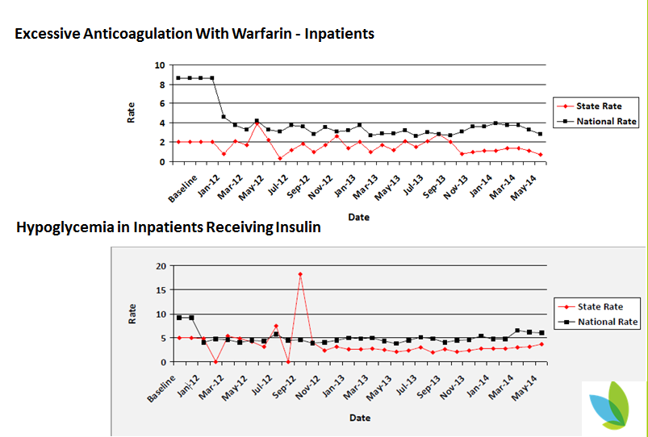
Colorado ADE Results

Slide 31
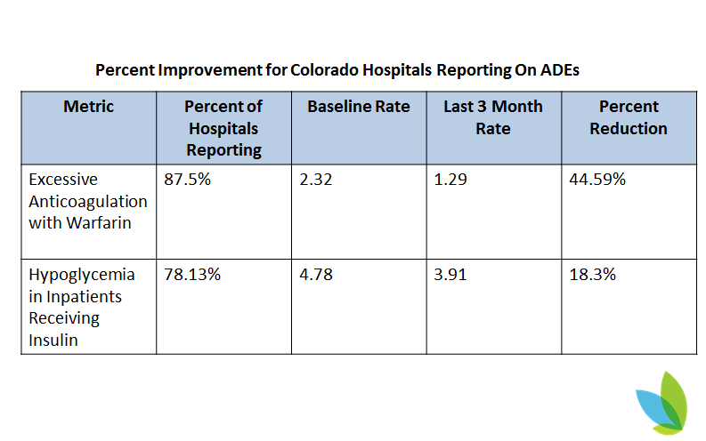
Colorado ADE Results

Slide 32
Overcoming Barriers for ADE Success
Standardizing All Measures for HEN 2014
Use of CHA Data Collection Tool
ADE Focus on February Webinar and at Regional Meetings in March & April 2014
In-depth Site Visits with Emphasis on ADE Data Collection
One-on-one Coaching via Phone calls and Emails
Connecting Struggling Hospitals with Mentors Hospitals

Slide 33
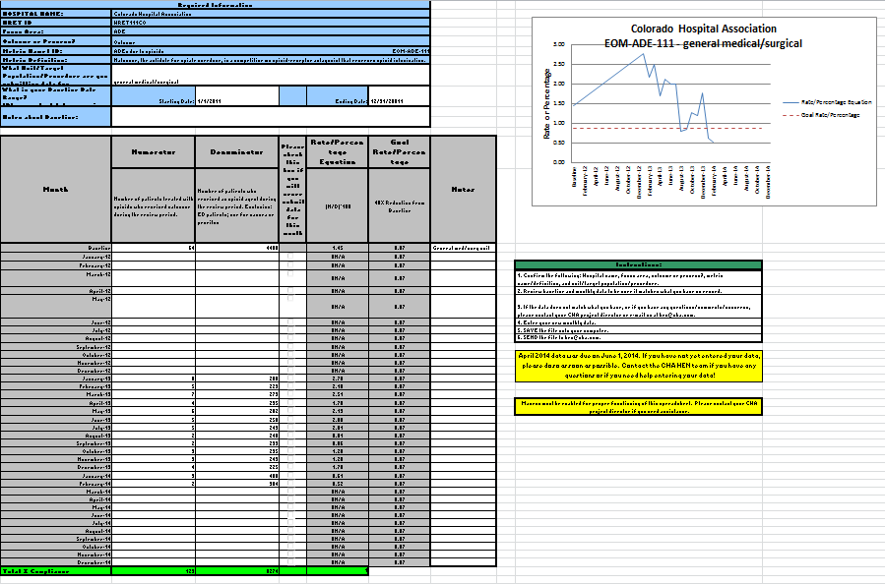

Colorado Data Collection Tool

Slide 34
Questions for HENs
What barriers did you find most challenging to overcome with your hospitals?
What strategies have you used to overcome these barriers?
What lessons have you learned while working with your hospitals to address challenges in tracking ADEs?
Please press 7# to respond via the phone
or you can respond in chat box

Slide 35
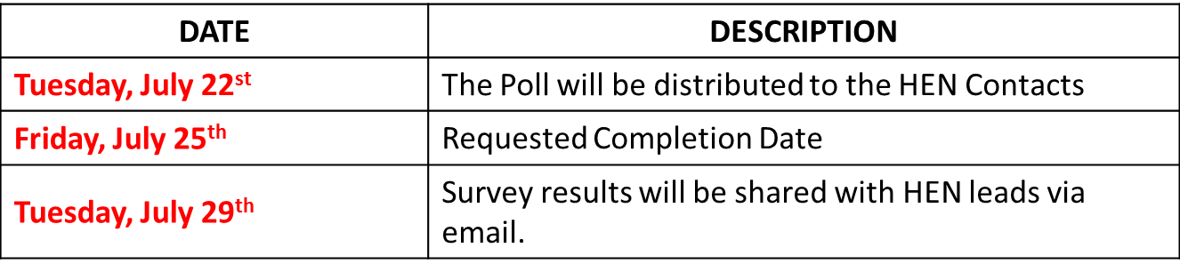
We Want to Hear from You
Please complete a short poll on the opportunities you see emerging as a result of the discussion of today’s principle.
This Polling Process has 3 Key Dates:
The email will include a hardcopy of the poll so you can consider your answers prior to answering the electronic poll.
Only one response per HEN is requested.
If you do not receive the poll, you can use the following link to submit:
https://survey.qualtrics.com/SE/?SID=SV_2gCs8EvBjWPrWwR

Slide 36
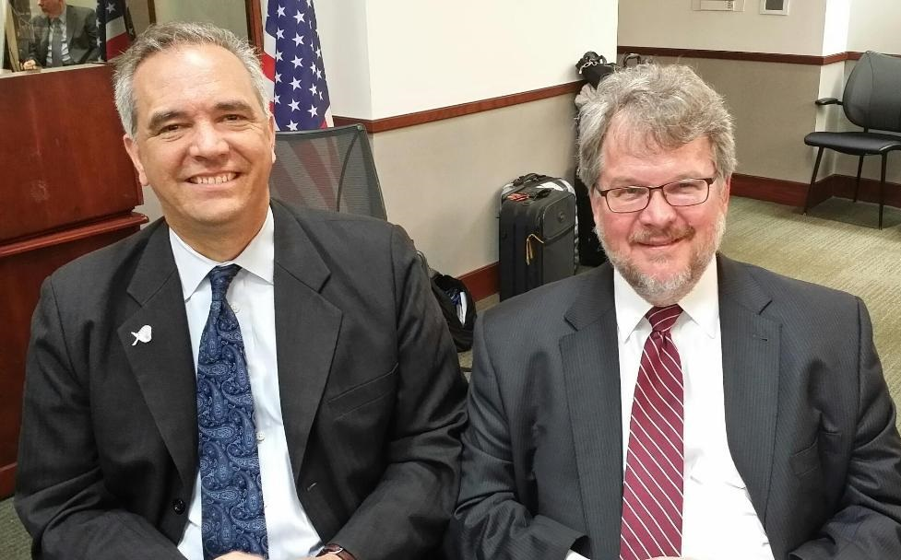
Closing Comments
Dennis Wagner and Paul McGann, MD
PfP Co-Directors
CMS

Slide 37
Thank you for joining us today!
Upcoming Event:
LEAPT Cross-Pollination:
Worker Safety
July 29, 2014

